Slide 1
Population Pyramids

Slide 2
Population pyramids are used to show the age & sex structure of countries.
They are very useful for comparing countries & looking at how the population structure of a country changes over time.
Population pyramids can give an indication of the stage of development of a country

Slide 3
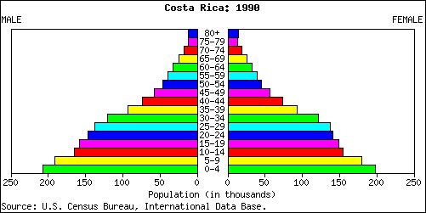
Costa Rica Population Pyramids

Slide 4
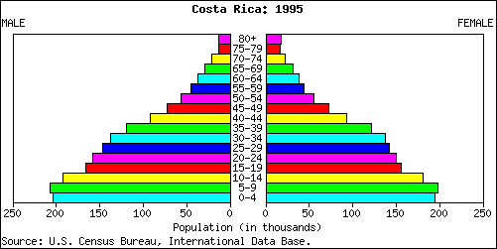

Slide 5
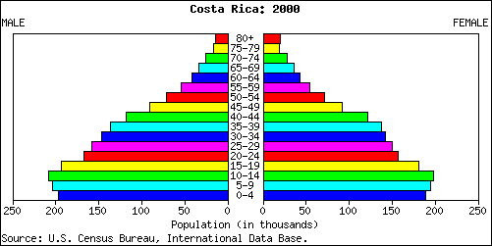

Slide 6
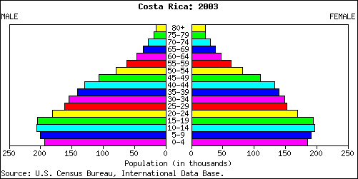

Slide 7
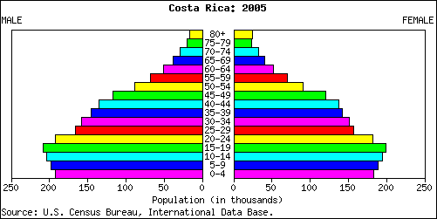

Slide 8
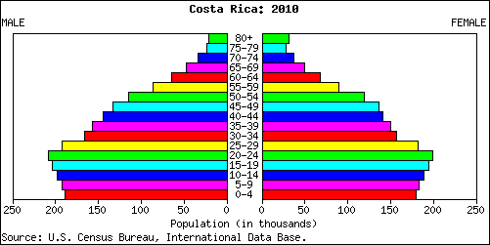

Slide 9
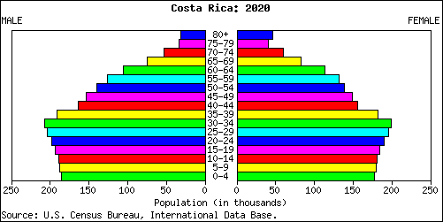

Slide 10
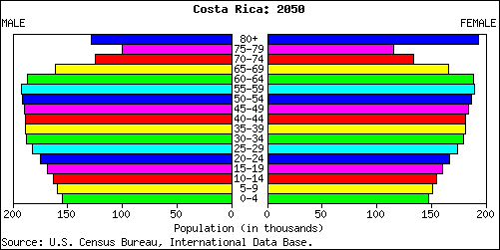

Slide 11
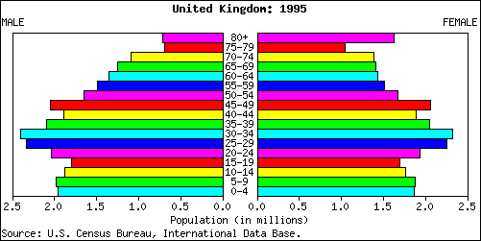
UK Population Pyramids

Slide 12
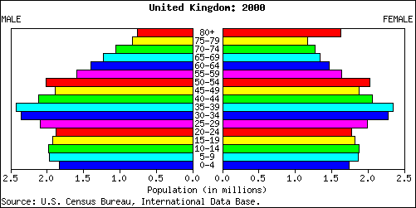

Slide 13
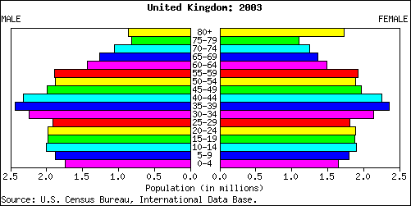

Slide 14
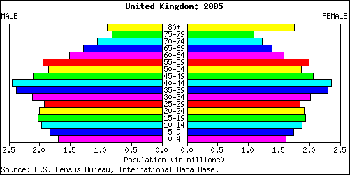

Slide 15
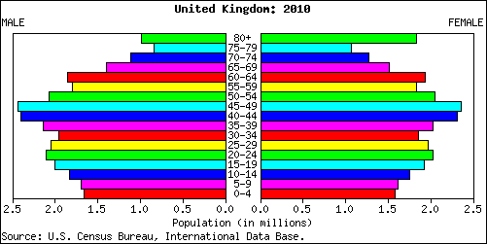

Slide 16
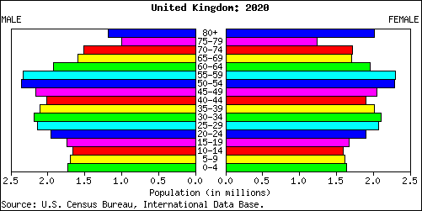

Slide 17
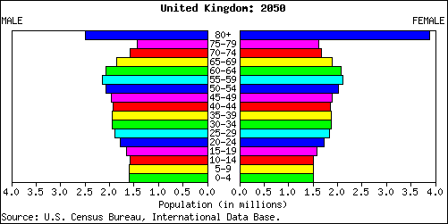

Slide 18
Tasks
Complete pyramids & explanations (p.353 Waugh).
Using the population data complete a population pyramid for Costa Rica & one for Cambodia.
You will need to add a % column before you can start drawing the pyramid .
For each pyramid: describe the shape & explain why it is this shape.

